Slide 1
PSCS-64 CUSTOMER SUPPORT CHATBOT WITH ML
PIP2001 Capstone Project
Review-0
Batch Number : CSE-G27
Roll Number | Student Name
20211CSE0382 | KIRAN R
20211CSE0378 | ARUN KUMAR P
20211CSE0386 | JISHNU KUMAR G S
20221LCS0022 | PRAVEEN KUMAR S
Under the Supervision of,
Mr. Md Zia Ur Rahman
Assistant Professor
School of Computer Science and Engineering
Presidency University
Name of the Program: B-Tech
Name of the HoD: Dr.Asif Mohammed
Name of the Program Project Coordinator: Mr.Amarnath JL/Dr.Jayanthi Kamalasekaran
Name of the School Project Coordinators: Dr. Sampath A K / Dr. Abdul Khadar A / Mr. Md Ziaur Rahman

Slide 2
CONTENT
Problem Statement
GitHub Link
Analysis of Problem Statement
Timeline of the Project
References

Slide 3
Problem Statement:
Organization: KG Info Systems Pvt Ltd
Category (Hardware / Software / Both) : Software
Problem Description: A chat bot which can interpret the customer complaints or queries, search the DB for resolution and in case new solution found, hand it over to support staff. Based on the conversation b/w customer and staff, update the DB, be prepared to handle similar queries in future.
Difficulty Level: Complex

Slide 4
GitHub Link
The GitHub link provided should have public access permission.
GitHub Link:
https://github.com/KIRAN0382/Chatbot.git

Slide 5
Analysis of Problem Statement
Technology Stack Components:
Frontend: Html , CSS , JavaScript
Backend : Python , ML Algorithm-NLP
Database : SQL database

Slide 6
Analysis of Problem Statement (contd...)
Software Requirements:
Windows OS , Visual Studio ,
Html , CSS , Java Script for fronted.
Python ML Algorithms-NLP for backend.
SQL Database for storing the Queries.

Slide 7
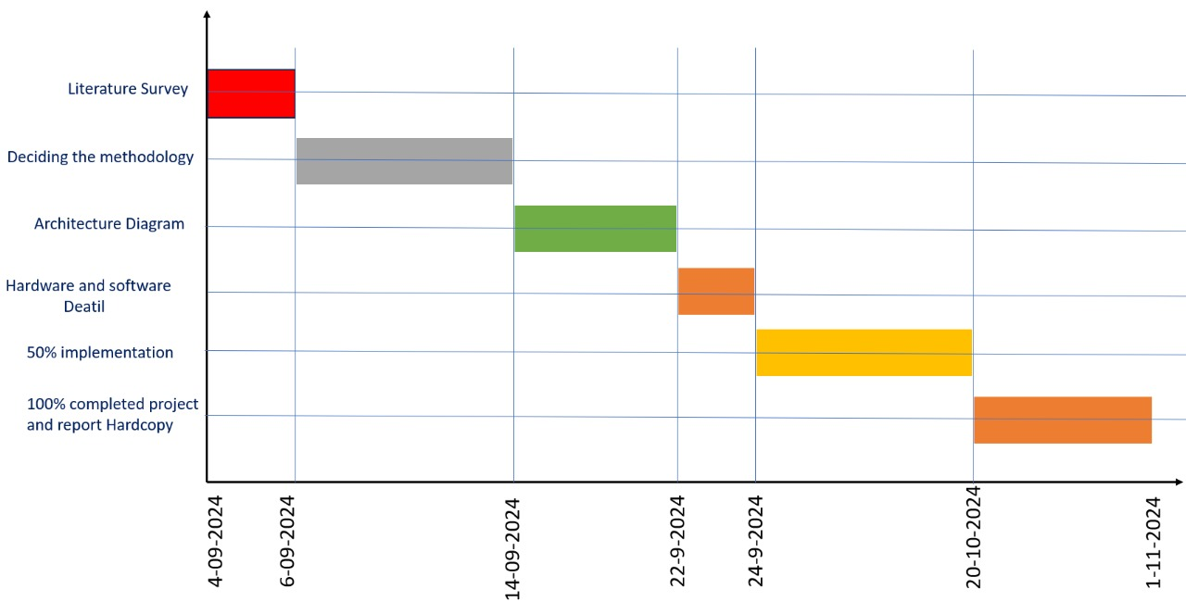
Timeline of the Project (Gantt Chart)

Slide 8
References (IEEE Paper format)
R. Madana Mohana, Bharat institute of Engineering and Technology, Hyderabad, Telangana and N. Pity, Indian Institute of Science, Bangalore, India. Advances in intelligent Systems and Computing(2020)- Customer Support Chatbot Using Machine Learning.
https://www.researchgate.net/publication/343980800_Customer_Support_Chatbot_Using_Machine_Learning
K. Jwala, G.N.V.G Sirisha, G.V. Padma Raju, International Journal of Recent Technology and Engineering (IJRTE) ISSN: 2277-3878, Volume-8 Issue-1S3, June 2019, developing a Chatbot using Machine Learning
https://www.ijrte.org/wp- content/uploads/papers/v8i1S3/A10170681S319.pdf
A step-by-step guide to pdf chatbots with ML and Ollama, Jul-2024
https://www.analyticsvidhya.com/blog/2023/10/a-step-by-step-guide-to-pdf-chatbots-with-langchain-and-ollama/
Binny Vyas (November 9, 2017). 6 key metrics to measure the performance of your chatbot. Retrieved from https://chatbotslife.com/
Sasa Arsovski, Imagineering Institute and City, University of London and Idris Muniru, Universiti Teknologi Malaysia: Analysis of the Chatbot Open Source Languages a AIML and Chatscript: A Review, February 2017. https://www.researchgate.net/publication/323279398_ANALYSIS_OF_THE_CHATBOT_OPEN_SOURCE_LANGUAGES_AIML_AND_CHATS CRIPT_A_Review
Will Gannon: An Interactive History of Chatbots, 21 Jul, 2017. http://blog.aylien.com/interactive-history-chatbots/
Pavel Surmenok: Chatbot Architecture, Sep 11, 2016. https://medium.com/@surmenok/chatbot-architecture-496f5bf820ed

Slide 9


